Slide 1
Quaternion Math
GAME 256

Slide 2
Quaternions
Orientation
Complex Numbers
Math with i
Graphing Complex Numbers
Quaternions

Slide 3

Orientation
$q=\left[\begin{matrix}w & v\end{matrix}\right]=\left[\begin{matrix}w & \begin{matrix}x & y & z\end{matrix}\end{matrix}\right]$
$q=cos\frac{θ}{2}+Asin\frac{θ}{2}$

Slide 4

Complex Numbers
In what world does $x^{2}=−1$
The IMAGINARY one.
Imaginary Unit:
$$i=\sqrt{−1}$$
Complex Number:
$$a+bi$$

Slide 5

Powers of i
$i=\sqrt{−1}$
$i^{2}=\sqrt{−1}⋅\sqrt{−1}=−1$ DO NOT USE: $\sqrt{−1}⋅\sqrt{−1}=\sqrt{\left(−1\right)\left(−1\right)}=1$
$i^{3}=i^{2}i=−i$
$i^{4}=i^{2}i^{2}=\left(−1\right)\left(−1\right)=1$
$i^{5}=i^{4}i=i$
And so on

Slide 6

Multiplication of i
Remember $i^{2}=−1$
$$(3−2i)(−4+5i)$$
$$=3\left(−4\right)+3\left(5i\right)+\left(−2i\right)\left(−4\right)+\left(−2i\right)\left(5i\right)$$
$$=−12+15i+8i−10i^{2}$$
$$=−12+23i−\left(−1\right)10$$
$$=−2+23i$$

Slide 7

Conjugate
$a+bi$ → $a−bi$
$−5−4i$ → $−5+4i$
Multiply a complex number by its conjugate to eliminate i

Slide 8

Graphing
$$2+3i$$

Slide 9

Quaternions
$i^{2}=j^{2}=k^{2}=−1$
$ij=−ji=k$
$jk=−kj=i$
$ki=−ik=j$
$\left[\begin{matrix}w & \begin{matrix}x & y & z\end{matrix}\end{matrix}\right]$ defines: $w+xi+yj+zk$

Slide 10
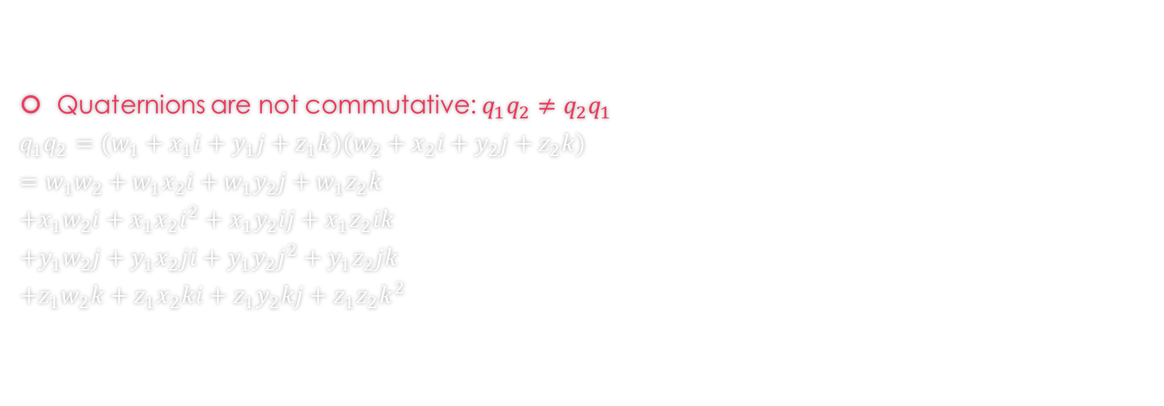
Multiplying Quaternions
Quaternions are not commutative: $q_{1}q_{2}≠q_{2}q_{1}$
$$q_{1}q_{2}=(w_{1}+x_{1}i+y_{1}j+z_{1}k)(w_{2}+x_{2}i+y_{2}j+z_{2}k)$$
$$=w_{1}w_{2}+w_{1}x_{2}i+w_{1}y_{2}j+w_{1}z_{2}k$$
$$+x_{1}w_{2}i+x_{1}x_{2}i^{2}+x_{1}y_{2}ij+x_{1}z_{2}ik$$
$$+y_{1}w_{2}j+y_{1}x_{2}ji+y_{1}y_{2}j^{2}+y_{1}z_{2}jk$$
$$+z_{1}w_{2}k+z_{1}x_{2}ki+z_{1}y_{2}kj+z_{1}z_{2}k^{2}$$

Slide 11

Substitute for i, j, k
Substitute the rules for multiplying i, j, k
$$=w_{1}w_{2}+w_{1}x_{2}i+w_{1}y_{2}j+w_{1}z_{2}k$$
$$+x_{1}w_{2}i+x_{1}x_{2}(−1)+x_{1}y_{2}(k)+x_{1}z_{2}(−j)$$
$$+y_{1}w_{2}j+y_{1}x_{2}(−k)+y_{1}y_{2}(−1)+y_{1}z_{2}(i)$$
$$+z_{1}w_{2}k+z_{1}x_{2}(j)+z_{1}y_{2}(−i)+z_{1}z_{2}(−1)$$

Slide 12

Collect i, j, k, and scalars
Collect the i, j, k, and scalar terms to find
$$q_{1}q_{2}=w_{1}w_{2}−x_{1}x_{2}−y_{1}y_{2}−z_{1}z_{2}$$
$$+\left(w_{1}x_{2}+x_{1}w_{2}+y_{1}z_{2}−z_{1}y_{2}\right)i$$
$$+\left(w_{1}y_{2}+y_{1}w_{2}+z_{1}x_{2}−x_{1}z_{2}\right)j$$
$$+\left(w_{1}z_{2}+z_{1}w_{2}+x_{1}y_{2}−y_{1}x_{2}\right)k$$

Slide 13
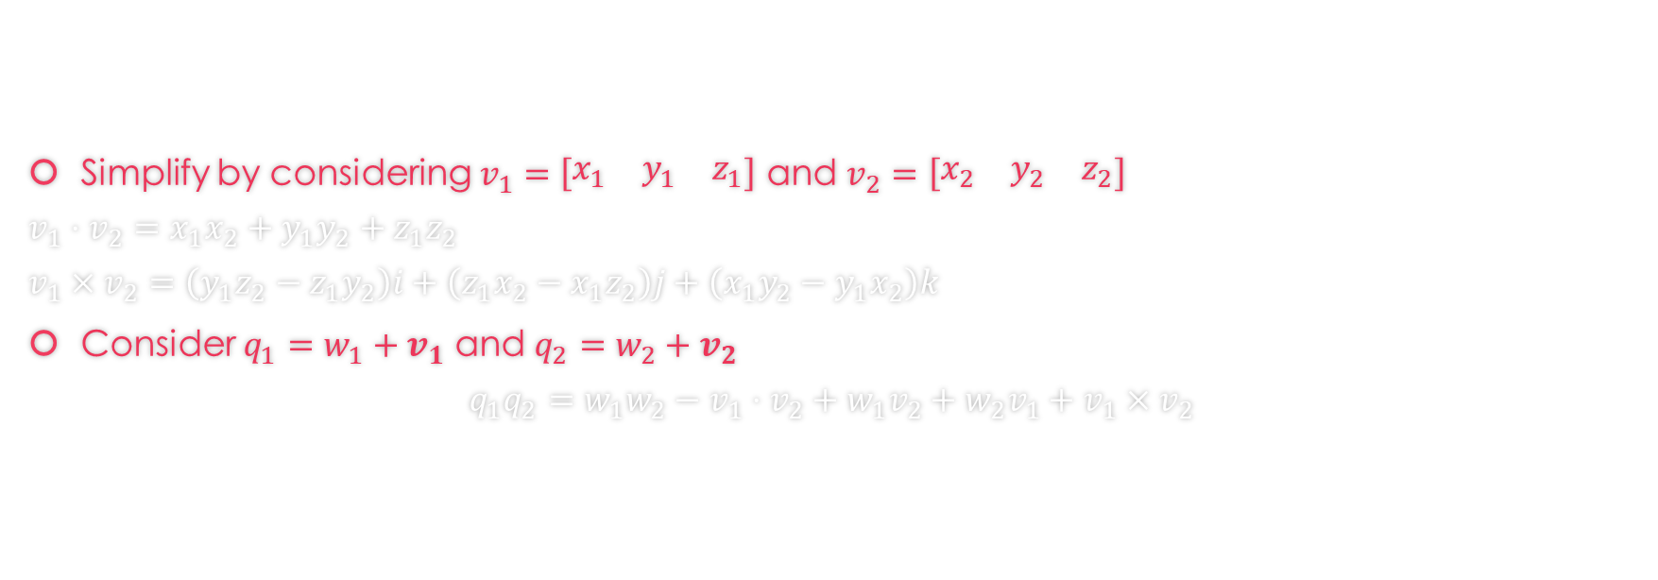
Simplify
Simplify by considering $v_{1}=\left[\begin{matrix}x_{1} & y_{1} & z_{1}\end{matrix}\right]$ and $v_{2}=\left[\begin{matrix}x_{2} & y_{2} & z_{2}\end{matrix}\right]$
$$v_{1}⋅v_{2}=x_{1}x_{2}+y_{1}y_{2}+z_{1}z_{2}$$
$$v_{1}×v_{2}=\left(y_{1}z_{2}−z_{1}y_{2}\right)i+\left(z_{1}x_{2}−x_{1}z_{2}\right)j+\left(x_{1}y_{2}−y_{1}x_{2}\right)k$$
Consider $q_{1}=w_{1}+v_{1}$ and $q_{2}=w_{2}+v_{2}$
$$q_{1}q_{2}=w_{1}w_{2}−v_{1}⋅v_{2}+w_{1}v_{2}+w_{2}v_{1}+v_{1}×v_{2}$$

Slide 14

Dot Product
$$q_{1}⋅q_{2}=\left[\begin{matrix}w_{1} & v_{1}\end{matrix}\right]⋅\left[\begin{matrix}w_{2} & v_{2}\end{matrix}\right]$$
$$q_{1}⋅q_{2}=w_{1}w_{2}+v_{1}⋅v_{2}$$
$$q_{1}⋅q_{2}=w_{1}w_{2}+x_{1}x_{2}+y_{1}y_{2}+z_{1}z_{2}$$

Slide 15

Magnitude
$$\left|q\right|=|\left[\begin{matrix}w & \begin{matrix}x & y & z\end{matrix}\end{matrix}\right]|$$
$$\left|q\right|=\sqrt{w^{2}+x^{2}+y^{2}+z^{2}}$$
$$\left|q\right|=\sqrt{w^{2}+{\left|v\right|}^{2}}$$

Slide 16
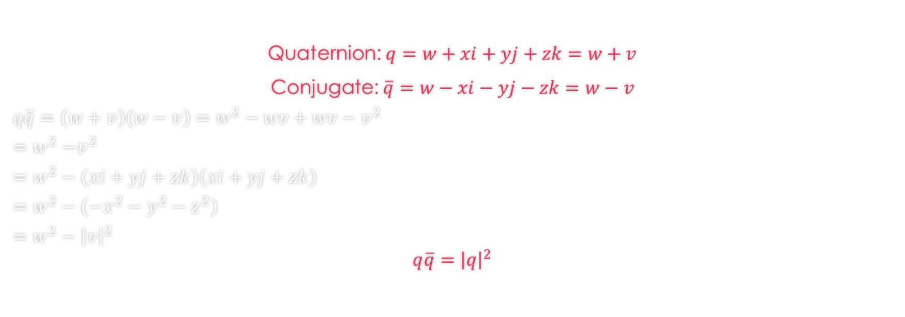
Conjugate
Quaternion: $q=w+xi+yj+zk=w+v$
Conjugate: $\overline{q}=w−xi−yj−zk=w−v$
$$q\overline{q}=\left(w+v\right)\left(w−v\right)=w^{2}−wv+wv−v^{2}$$
$${=w}^{2}−v^{2}$$
$$=w^{2}−\left(xi+yj+zk\right)\left(xi+yj+zk\right)$$
$$=w^{2}−\left(−x^{2}−y^{2}−z^{2}\right)$$
$$=w^{2}−{\left|v\right|}^{2}$$
$$q\overline{q}={\left|q\right|}^{2}$$

Slide 17

Inverse
$$q\overline{q}={\left|q\right|}^{2}$$
$$\frac{q\overline{q}}{{\left|q\right|}^{2}}=1$$
$$qq^{−1}=1=\frac{q\overline{q}}{{\left|q\right|}^{2}}$$
$$q^{−1}=\frac{\overline{q}}{{\left|q\right|}^{2}}$$

Slide 18

Rotation
Point $P=xi+yj+zk$ rotated by quaternion q
$$φ_{rotation}\left(P\right)=qPq^{−1}$$
^
Mmmm, a sandwich

Slide 19
FIN

